Slide 1
Complexity Analysis

Slide 2
Data Structure
Data structures are the way of organizing data in computer for effective use of the data.

Slide 3
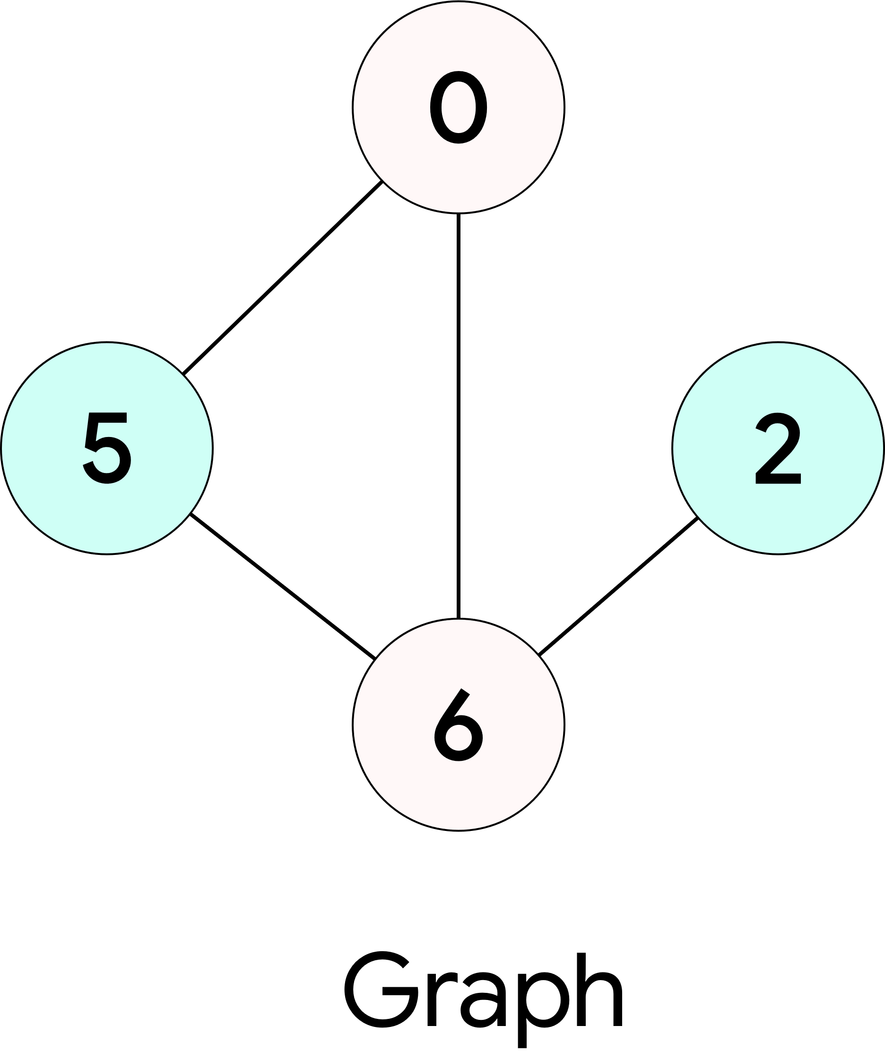
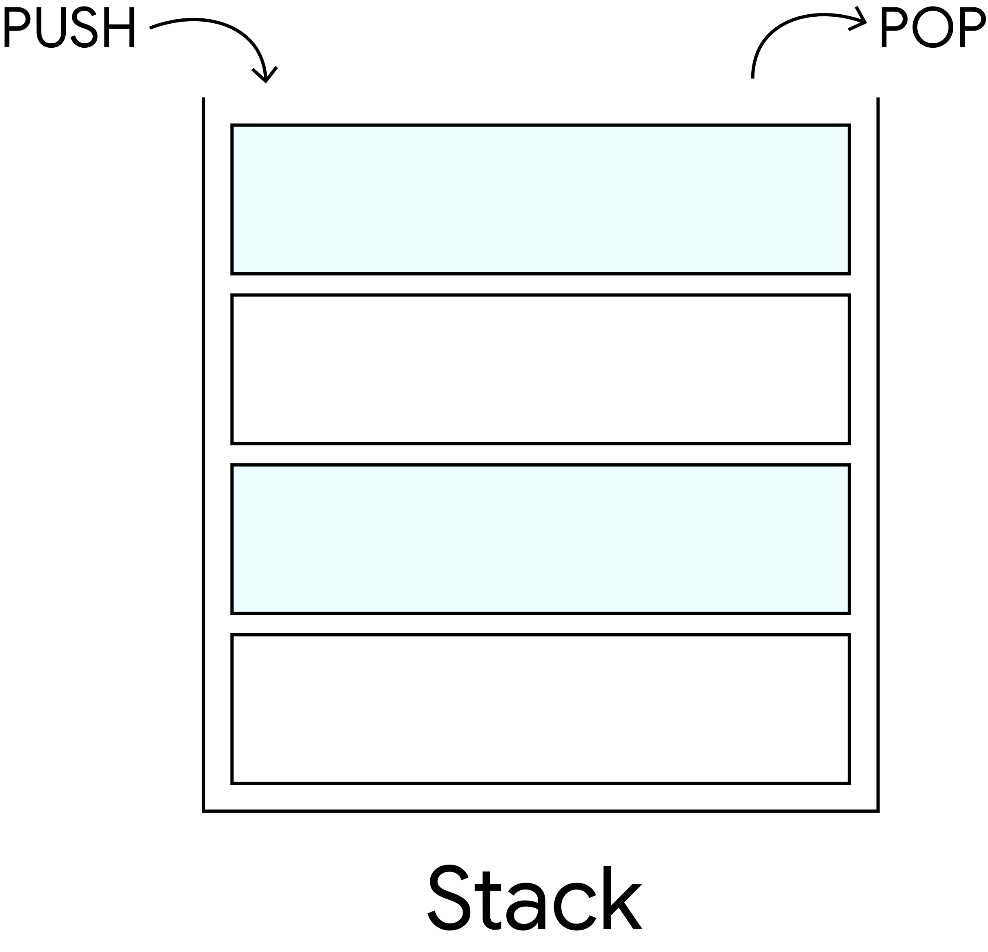
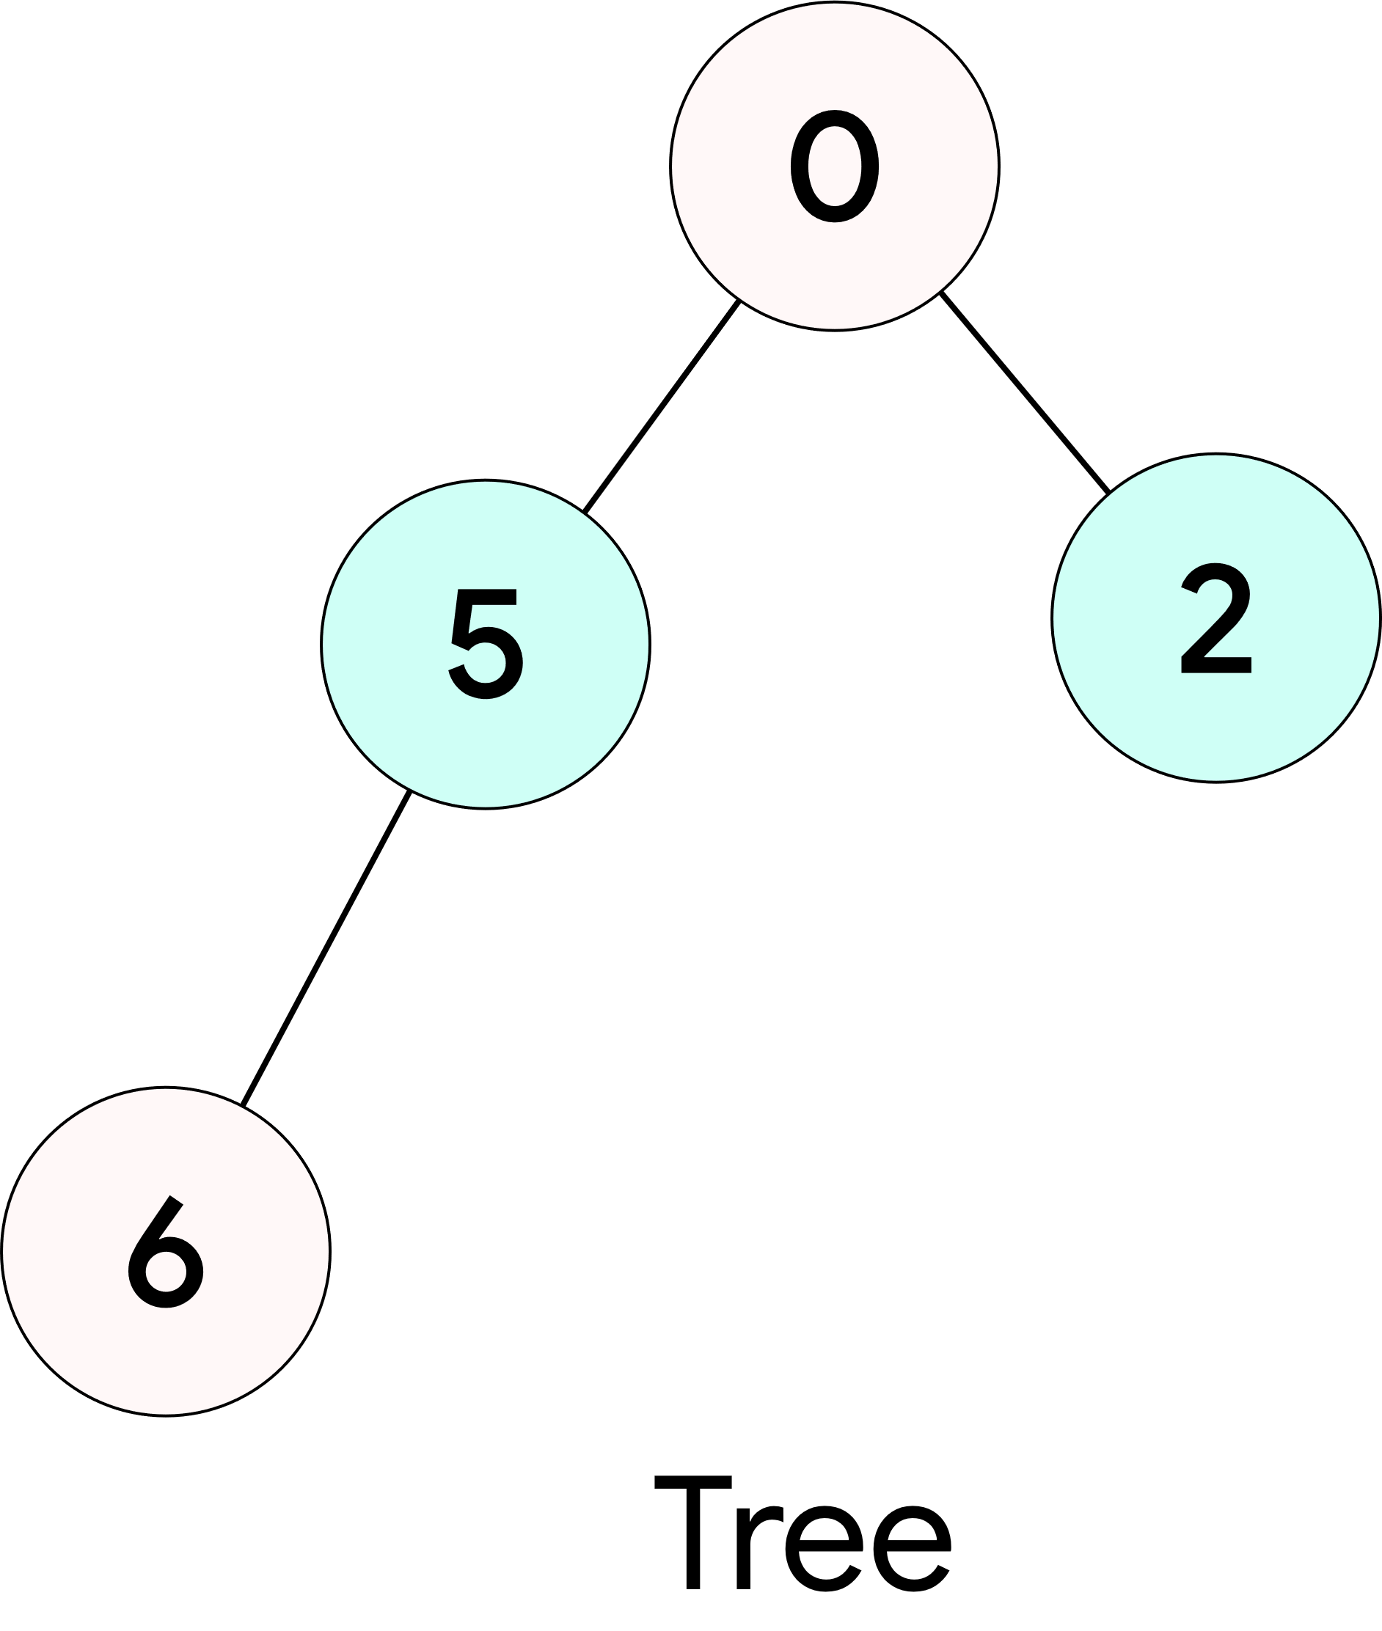
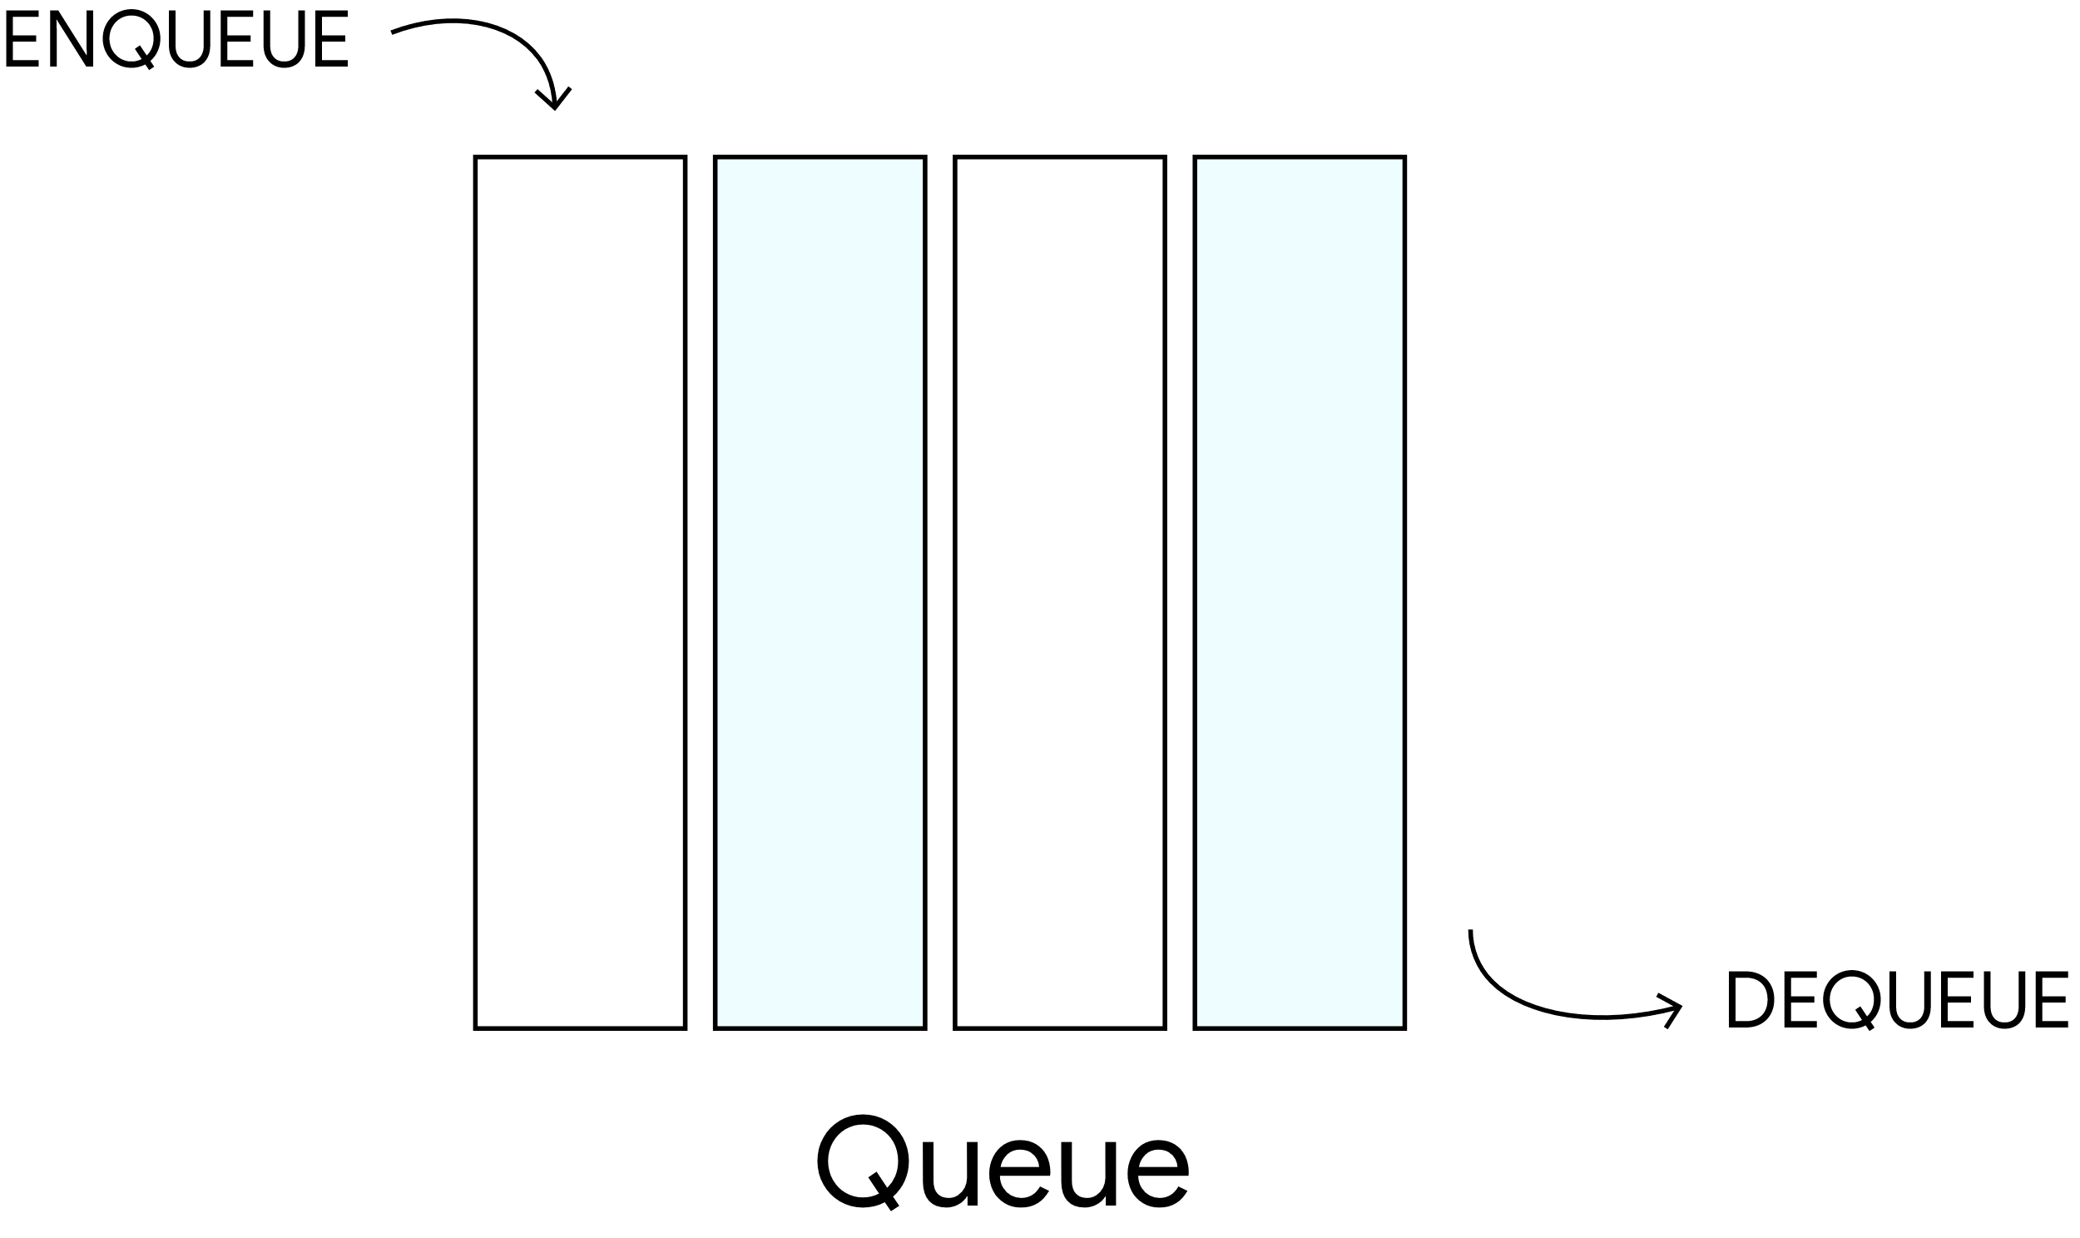
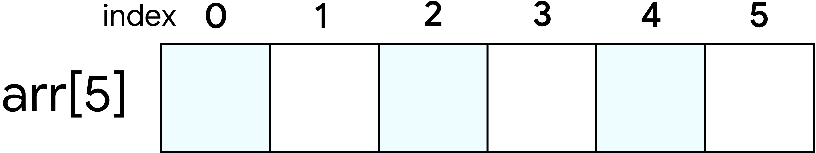
Types of Data Structures
NON
In nonlinear data structure, elements are stored in non-contiguous memory locations.
When the elements are stored on contiguous memory locations then data structure is called linear data structure.
For Example
As the elements are stored linearly, the structure supports single-level storage of data. And hence, traversal of the data is achieved through a single run only.
Unlike linear data structures, elements in non-linear data structures are not in any sequence. Instead they are arranged in a hierarchical manner where one element will be connected to one or more elements.
Implementation of the linear structure of data in a computer’s memory is easy as the data is organized sequentially.
Non-linear data structures are further divided into graph and tree based data structures.
190
200
201
202
Linear Data Structures
MEMORY LOCATIONS
Non-Linear Data Structures

